Slide 1


MobiCare
Healthcare System
Supervised By: Prof. Doaa Saad

Slide 2
Our Team

Slide 3

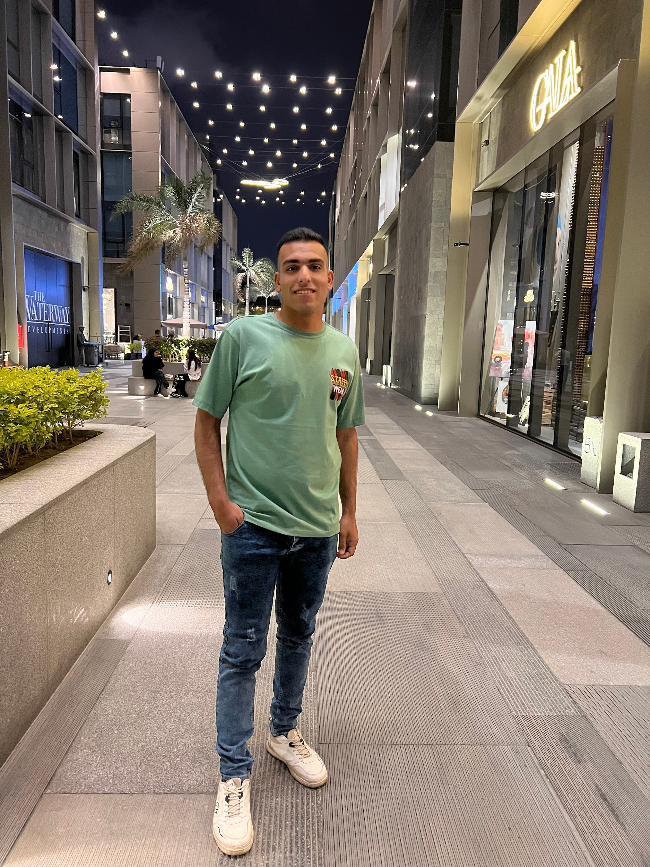


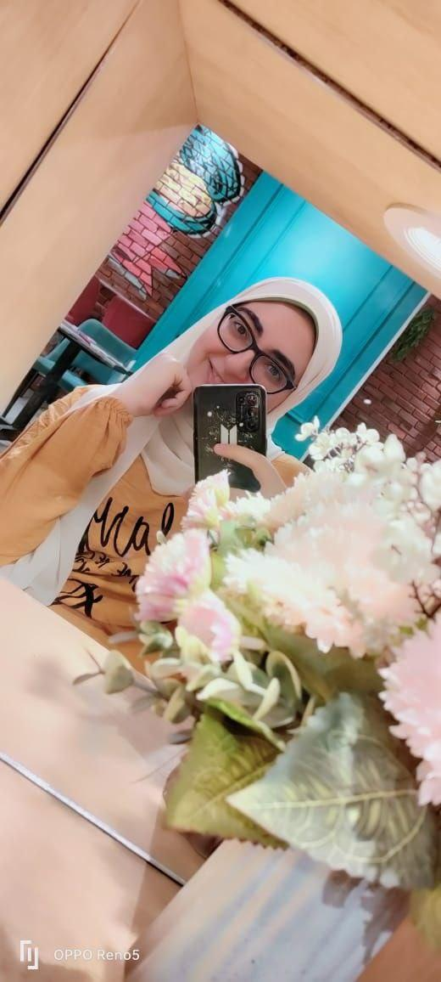
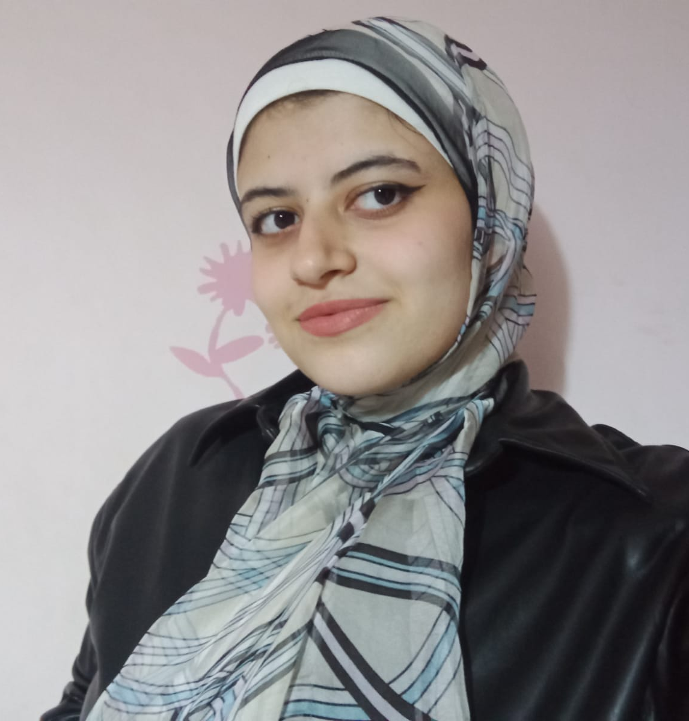
Mohammed Moataz
Fares Hesham
Omar Anas
Gerges Milad
Heba Adel
Reem Hesham

Slide 4
Content
01
02
03
04
05
Problem Definition
MobiCare
Competitive Analysis
Features
Technologies
06
07
08
09
BlockChain
Authentication
Limitations
Future Work

Slide 5
Problem Definition

Slide 6
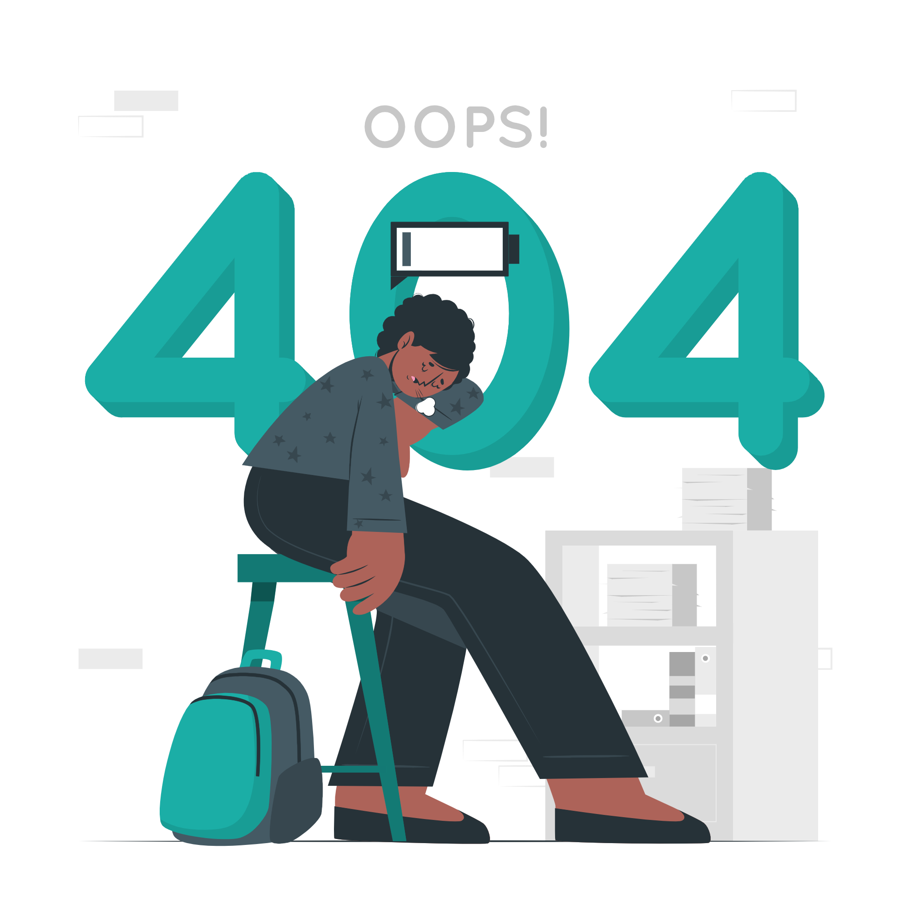
Sometimes patients find it difficult to go to doctors

Slide 7

Patients don’t know doctors around them.

Slide 8

The patient’s history is not always available.

Slide 9

Patients ignore and forget their medications.

Slide 10
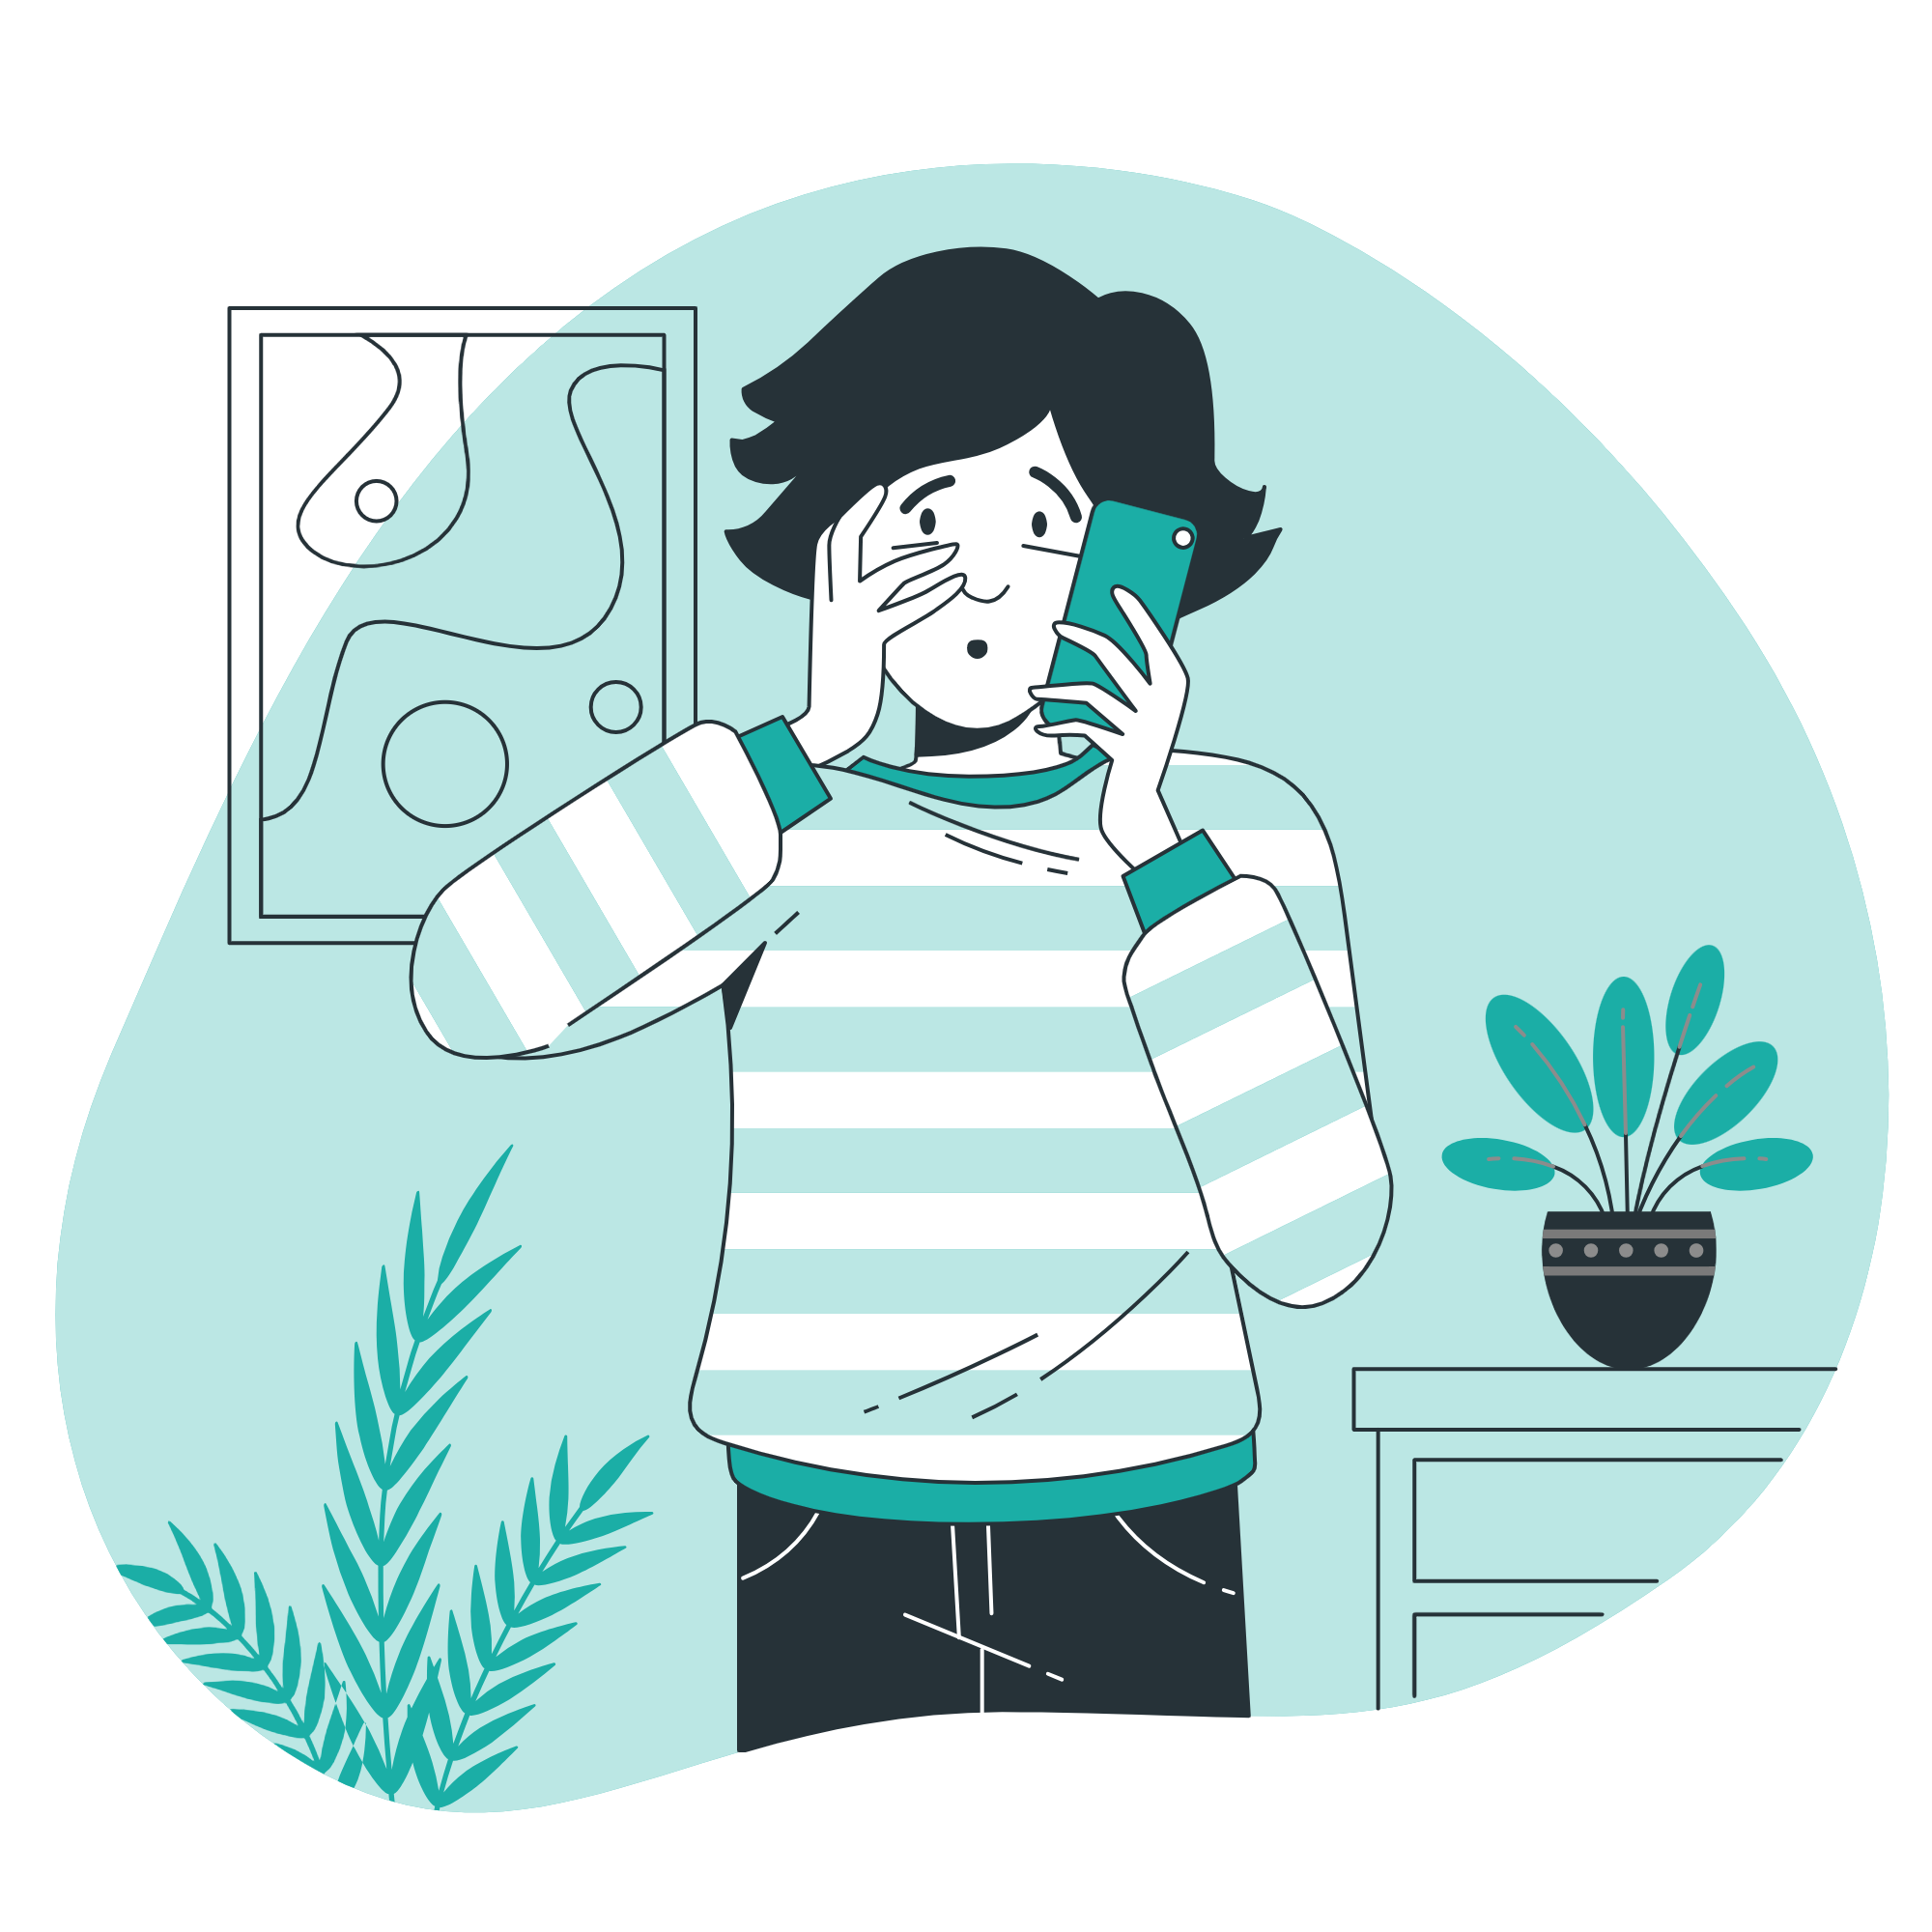
The patient has a lack of awareness.

Slide 11
Competitive Analysis
 | MobiCare | Vezeeta | Doctor fly | Housepital
Home Visits
Keep prescriptions
First aid tips

Slide 12
MobiCare

Slide 13

All the information you need
MobiCare is a healthcare System that facilitates communications between doctors and their patients.

Slide 14
Features

Slide 15

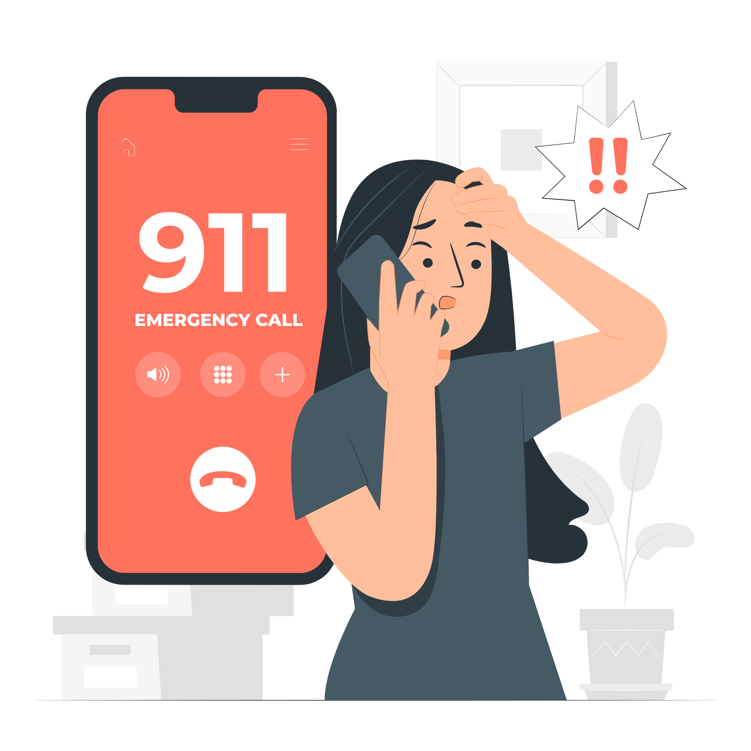
System features
Provide a section for emergency contacts.
Keeping the patient's medical prescriptions.

Slide 16

System features
Provide a section for first aid tips.

Slide 17


Doctor features
Chatting with patients and calling them.
Providing a medical reports about patient situation.

Slide 18
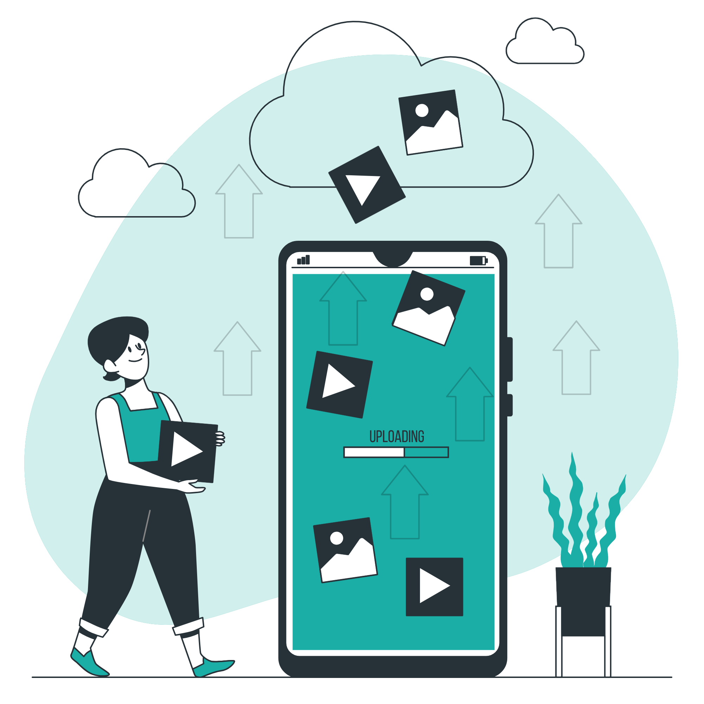

Doctor features
Scheduling tasks
Uploading videos and articles.

Slide 19

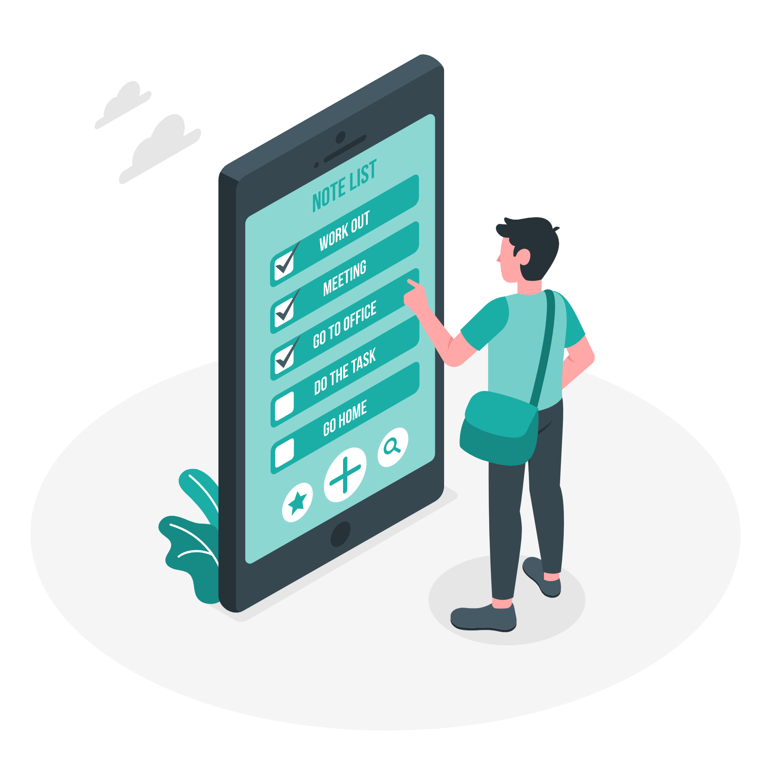
Doctor features
Adding a note to patients.
Adding patient to the patient’s list

Slide 20

Patient features
Chatting with doctors and calling them.
Searching for doctors.

Slide 21

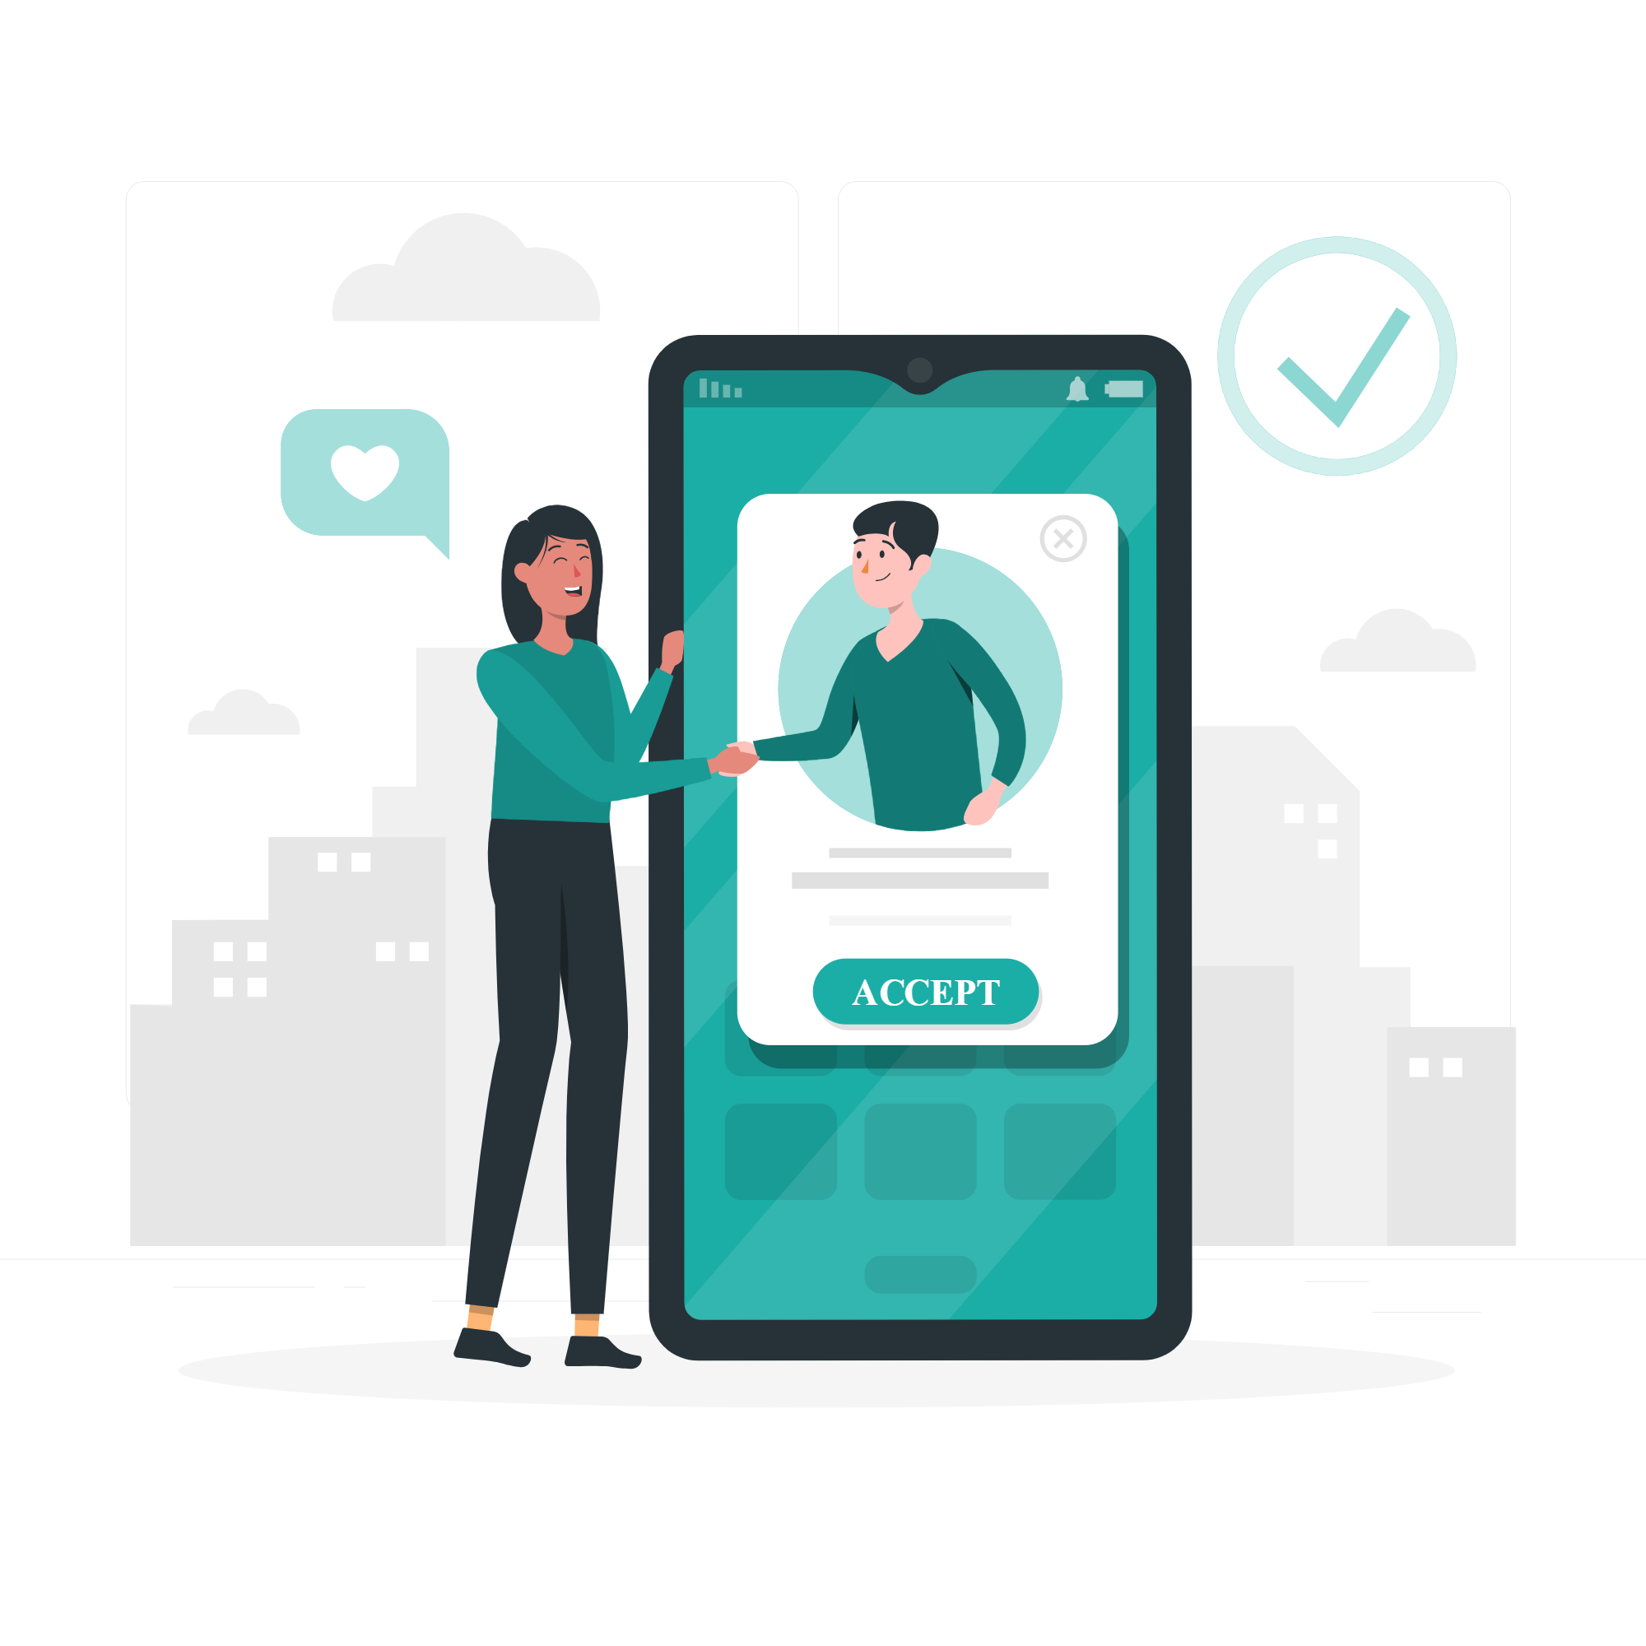
Patient features
Sending home visit requests.
Scheduling medication.

Slide 22
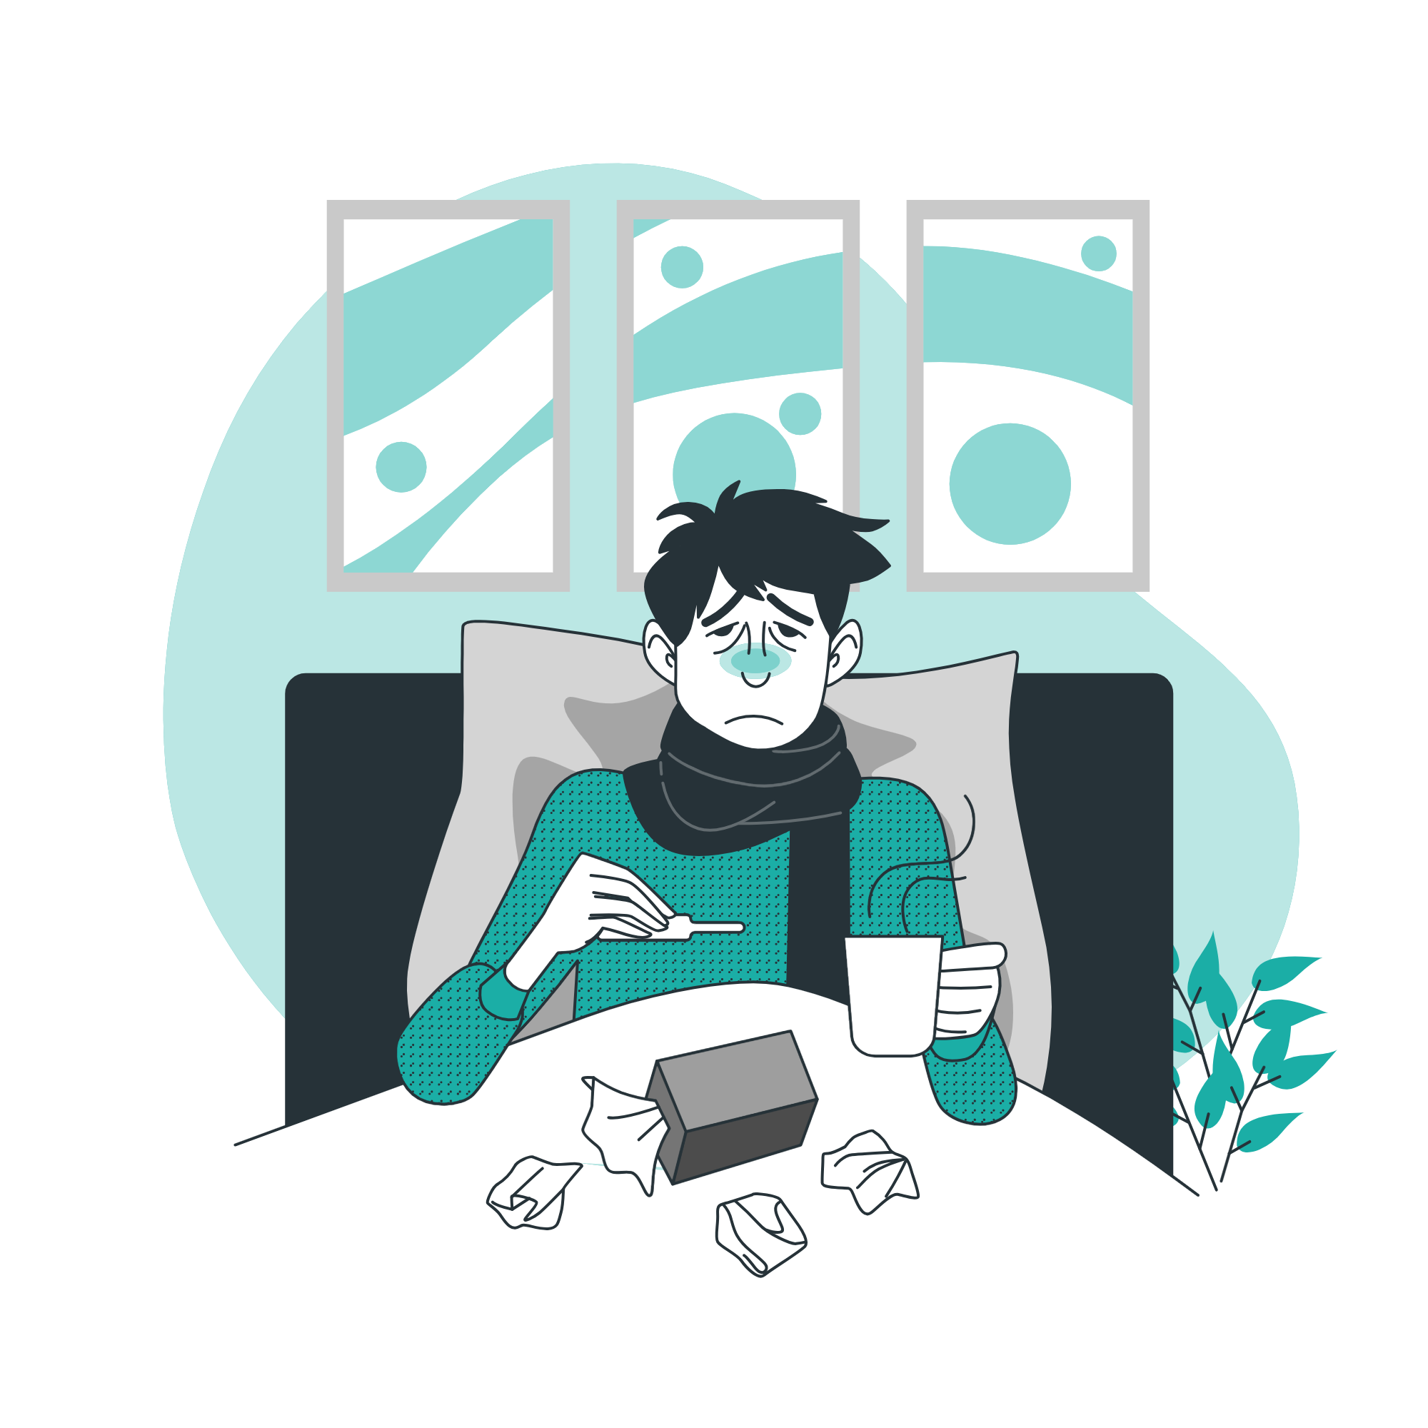
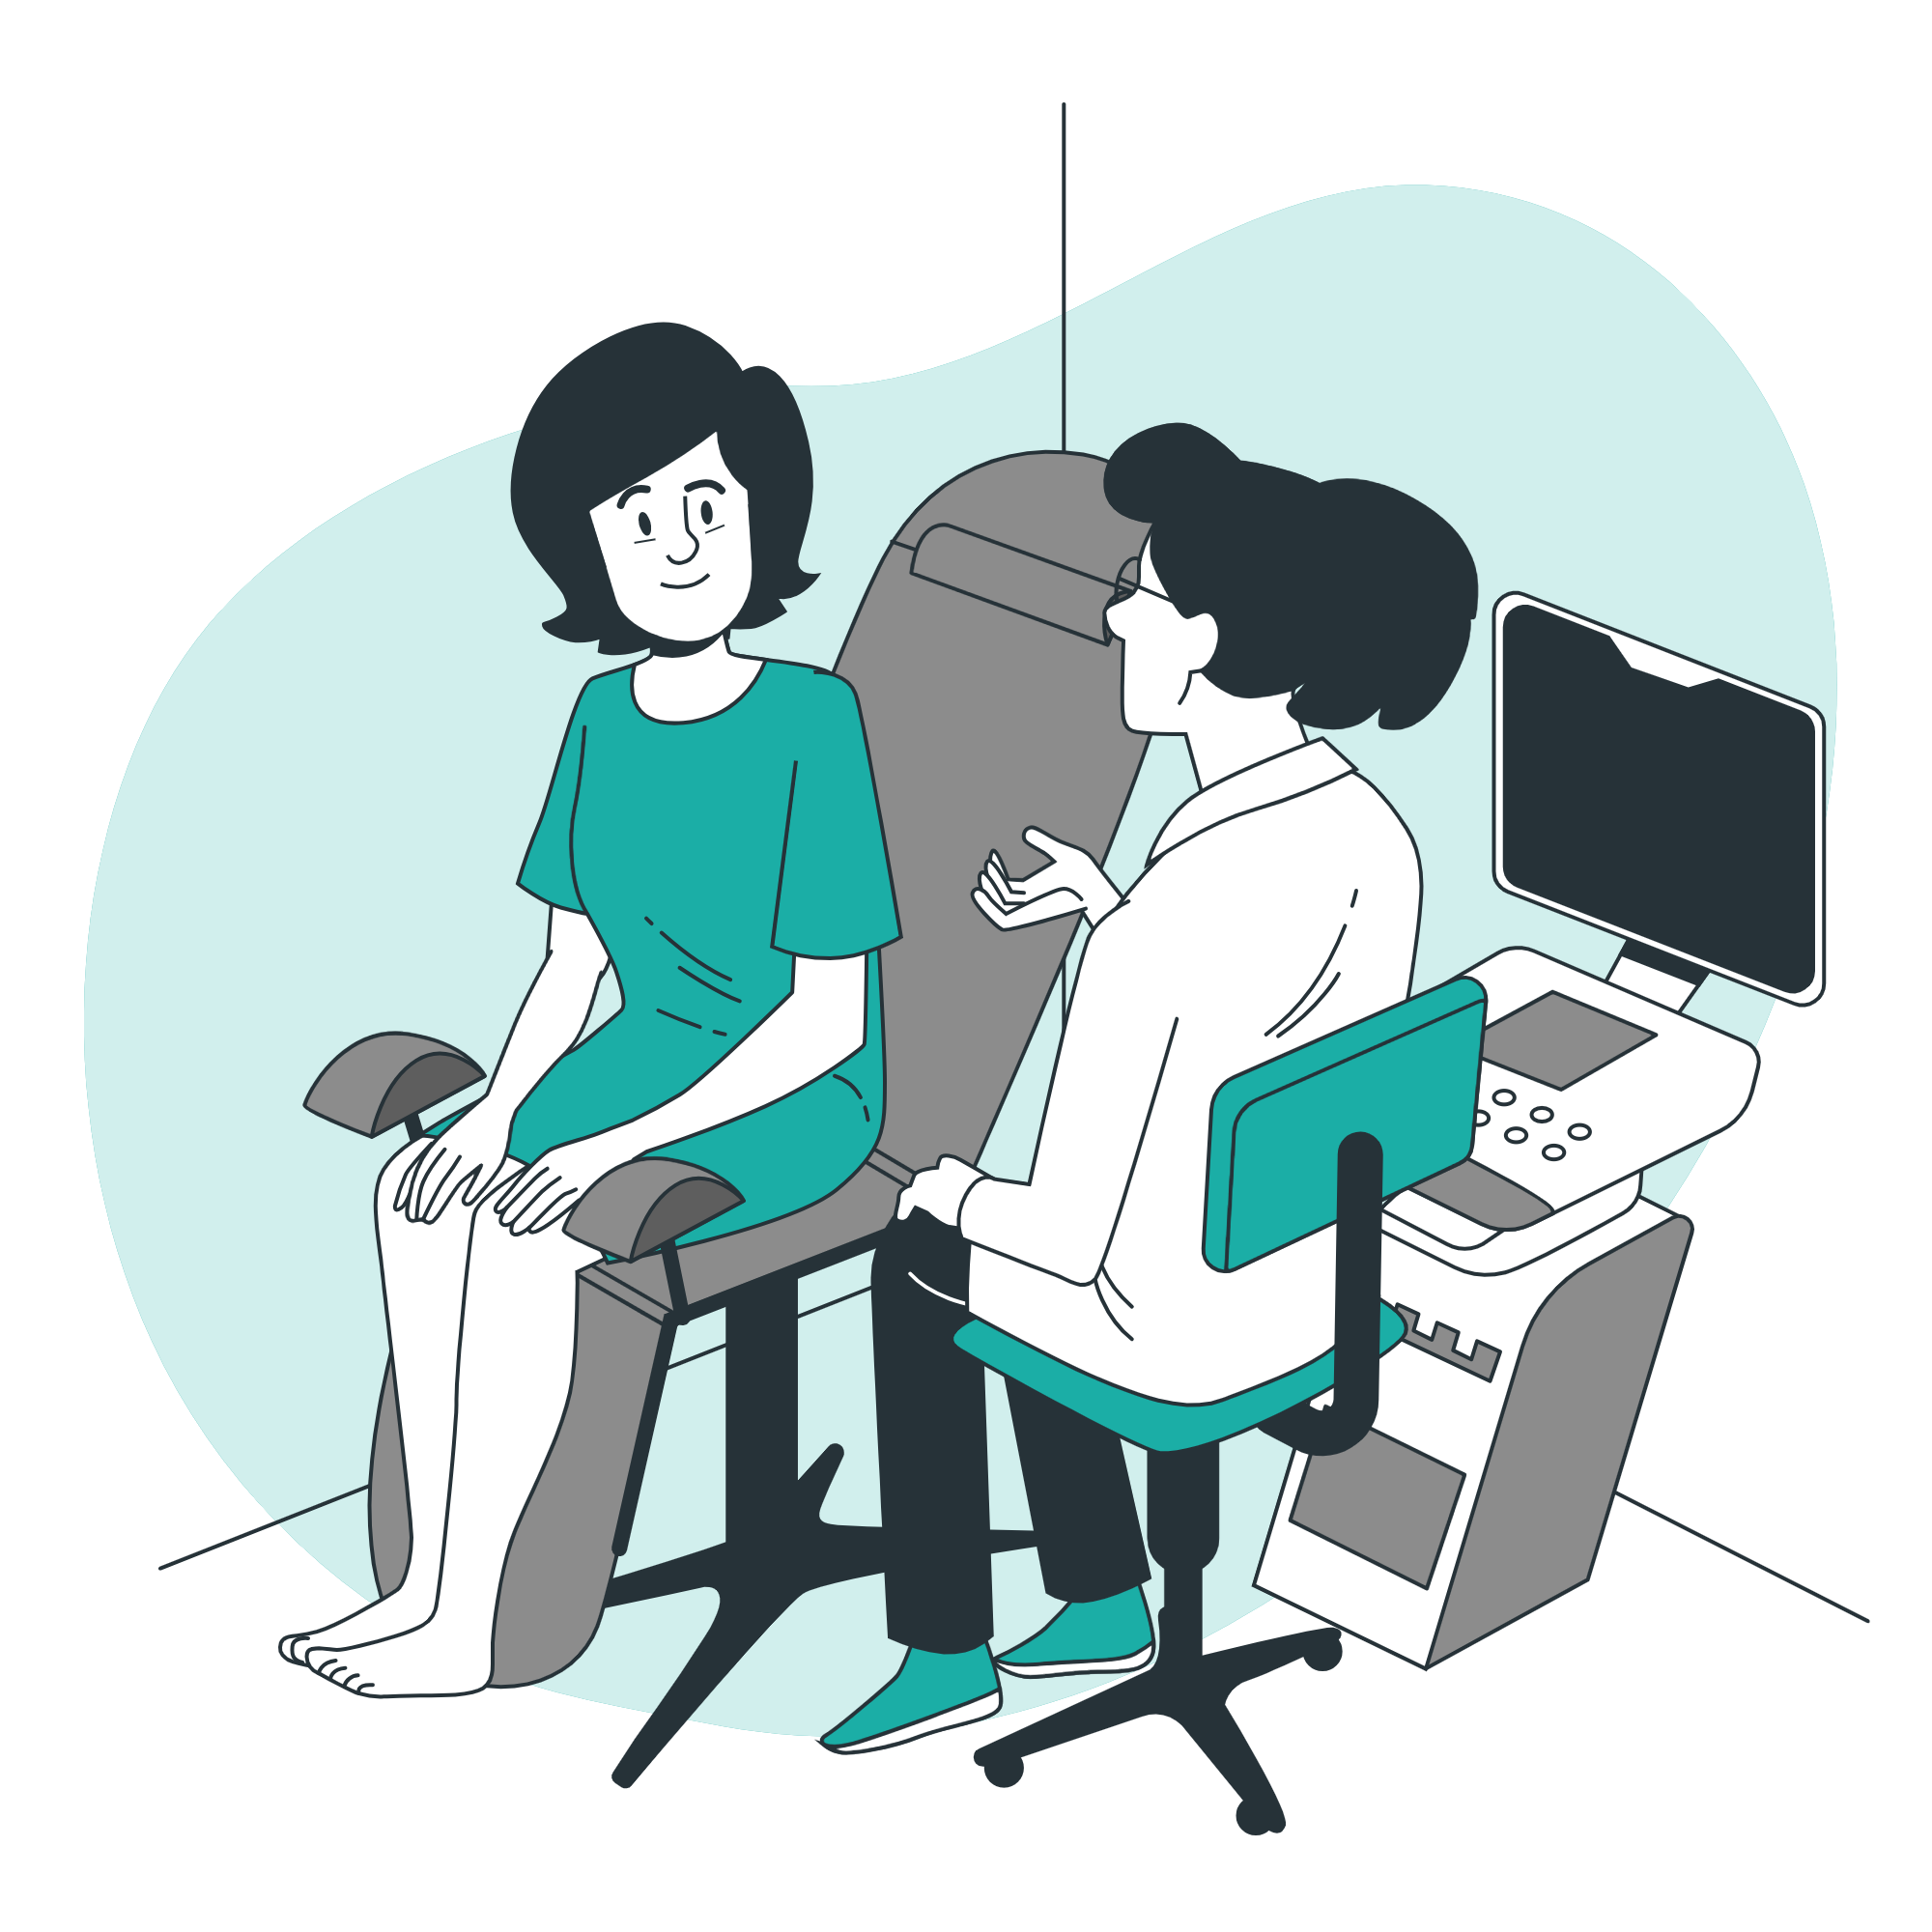
Patient features
Check illness history.
Adding symptoms

Slide 23
Technologies

Slide 24
Mobile
Flutter
Back-End
Node.JS
Ethereum
BlockChain
MySQL
Database

Slide 25
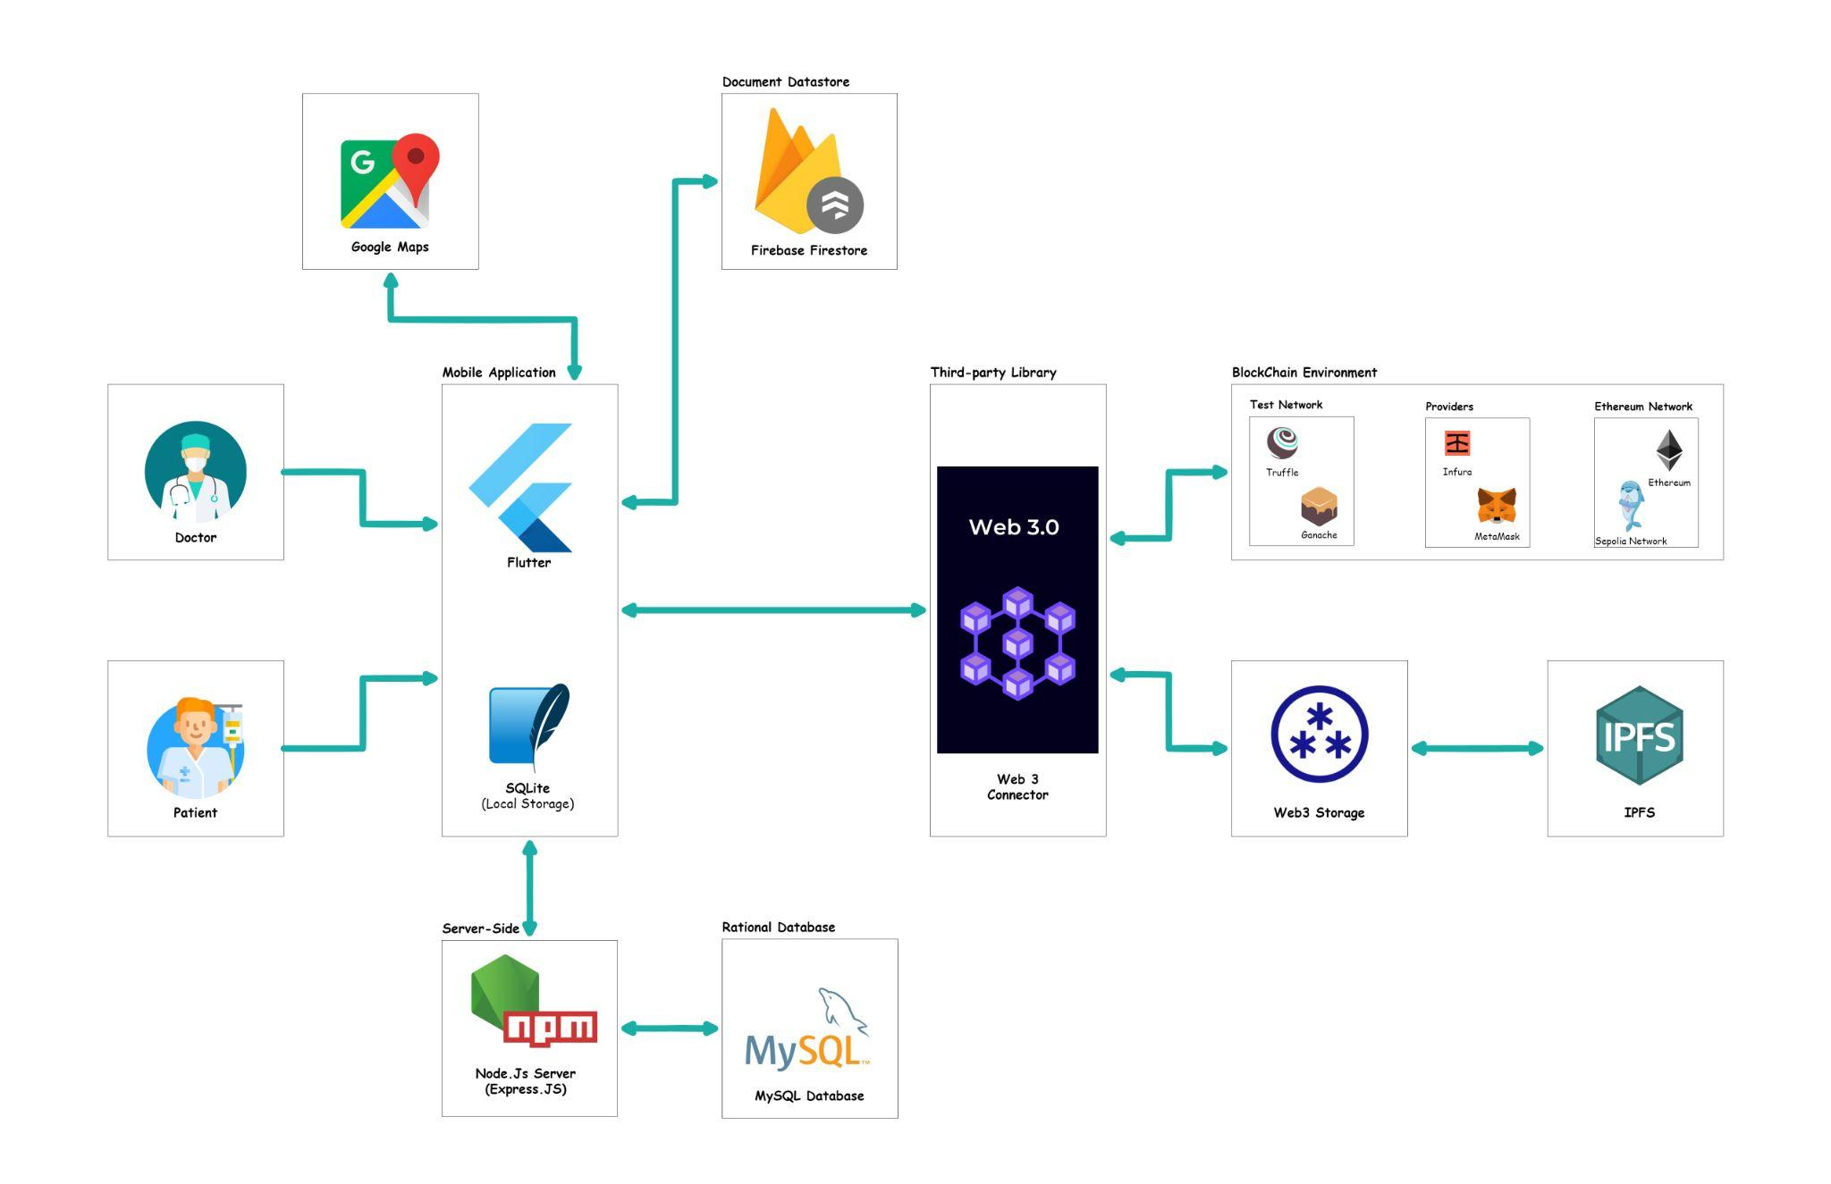

Slide 26

BlockChain
BlockChain is a distributed open ledger of transactions that is duplicated and distributed across the entire network, and stores data in a way that makes it difficult or impossible to change, or hack.

Slide 27

Smart Contracts
Smart contracts are simply programs stored on a blockchain that run when predetermined conditions are met.

Slide 28



Local Environment
Solidity
Truffle
Ganache

Slide 29

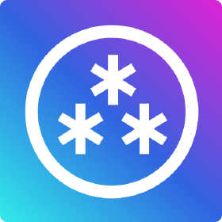

Providers
Infura
Web3.Storage
MetaMask

Slide 30



BlockChain Network
Sepolia Testnet
IPFS
Ethereum

Slide 31
Authentication
&
Authorization

Slide 32
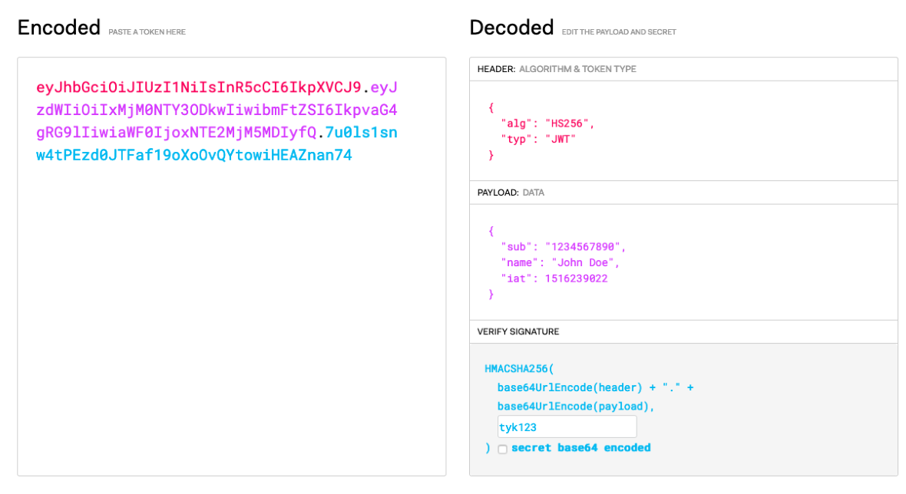
JWT Signature

Slide 33


Token based Authentication system
User logs in , server checks creds
Refresh and access Token Generated/stored in local storage
Provide Token in headers with all reqs
Providing refresh token to get a new access Token

Slide 34
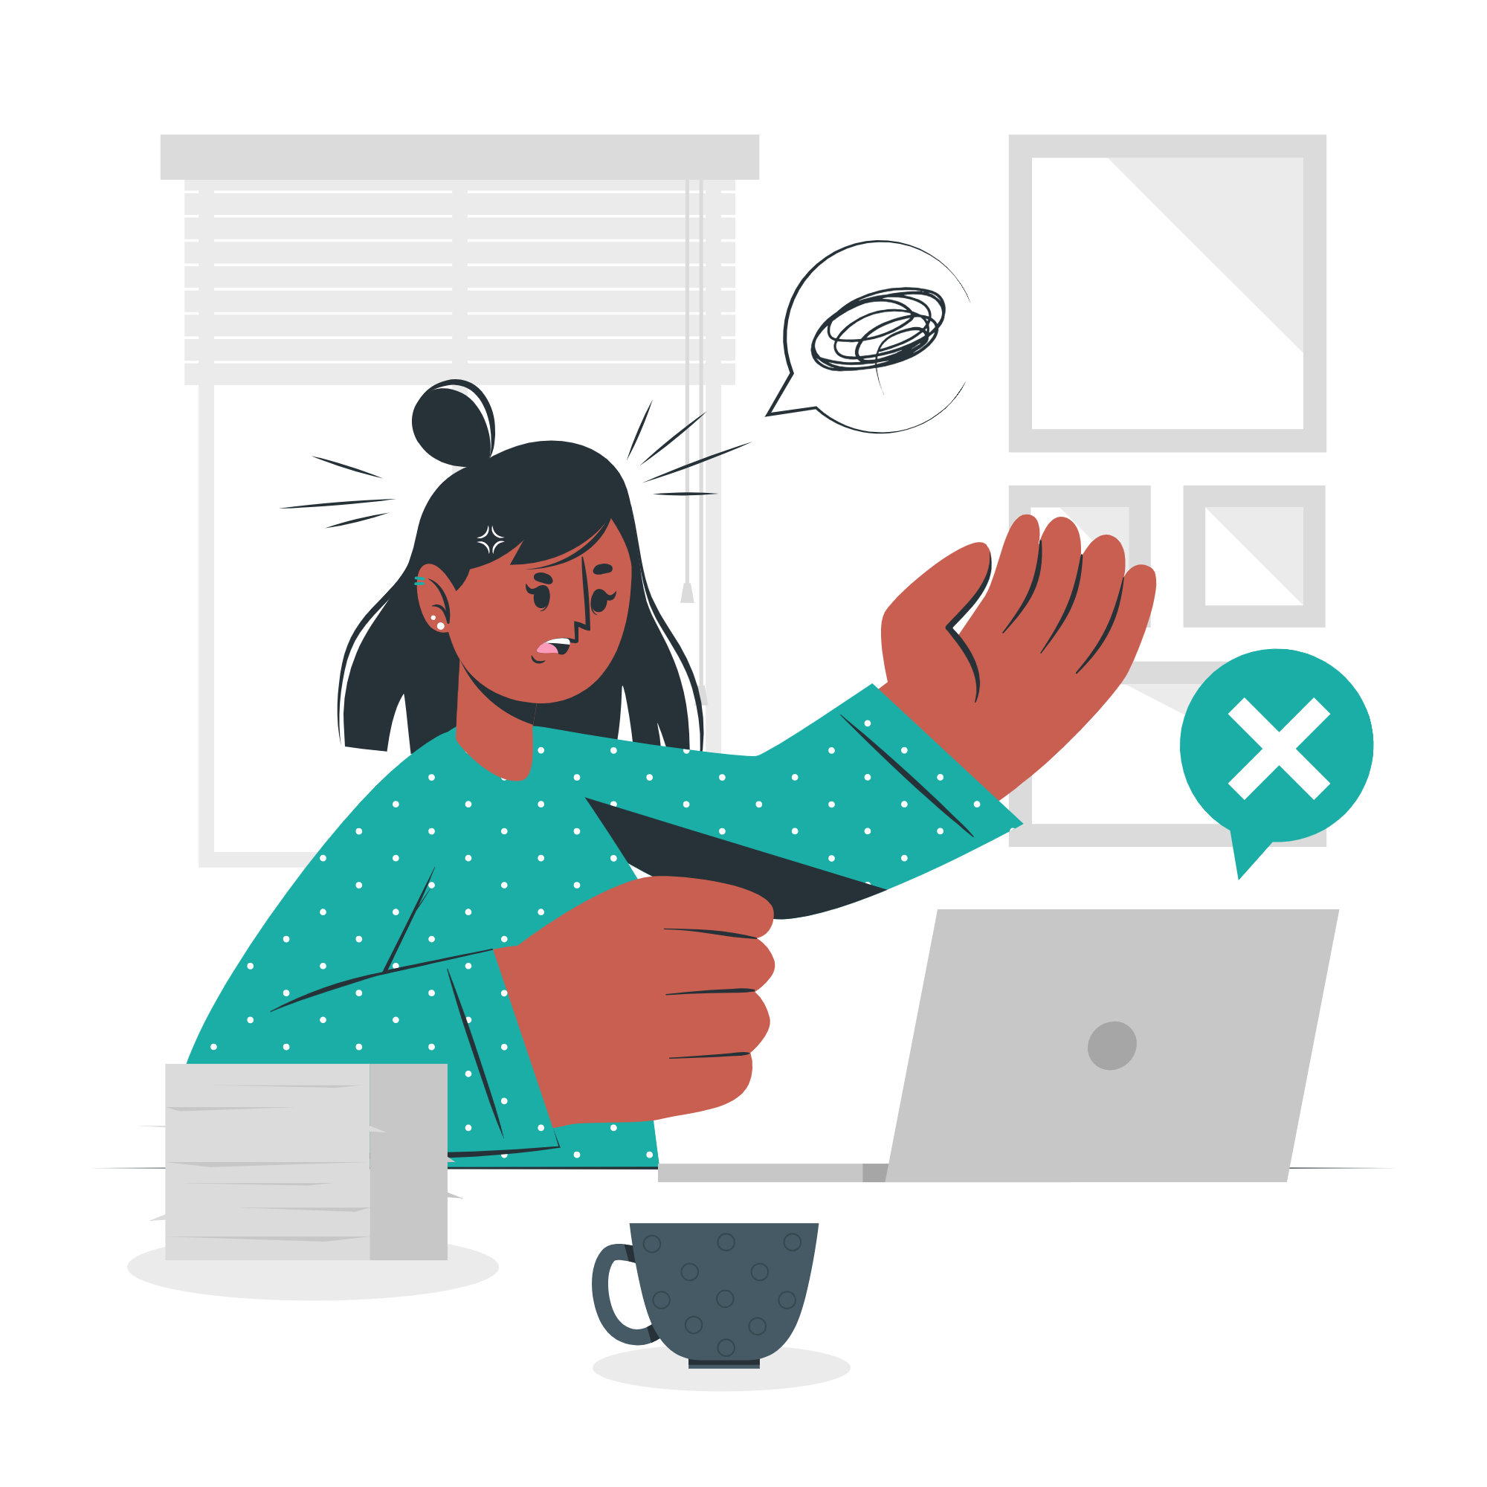
Limitations
Adding Records:
Adding records on blockchain was considered a limitation as we needed ethereum and it was not available

Slide 35
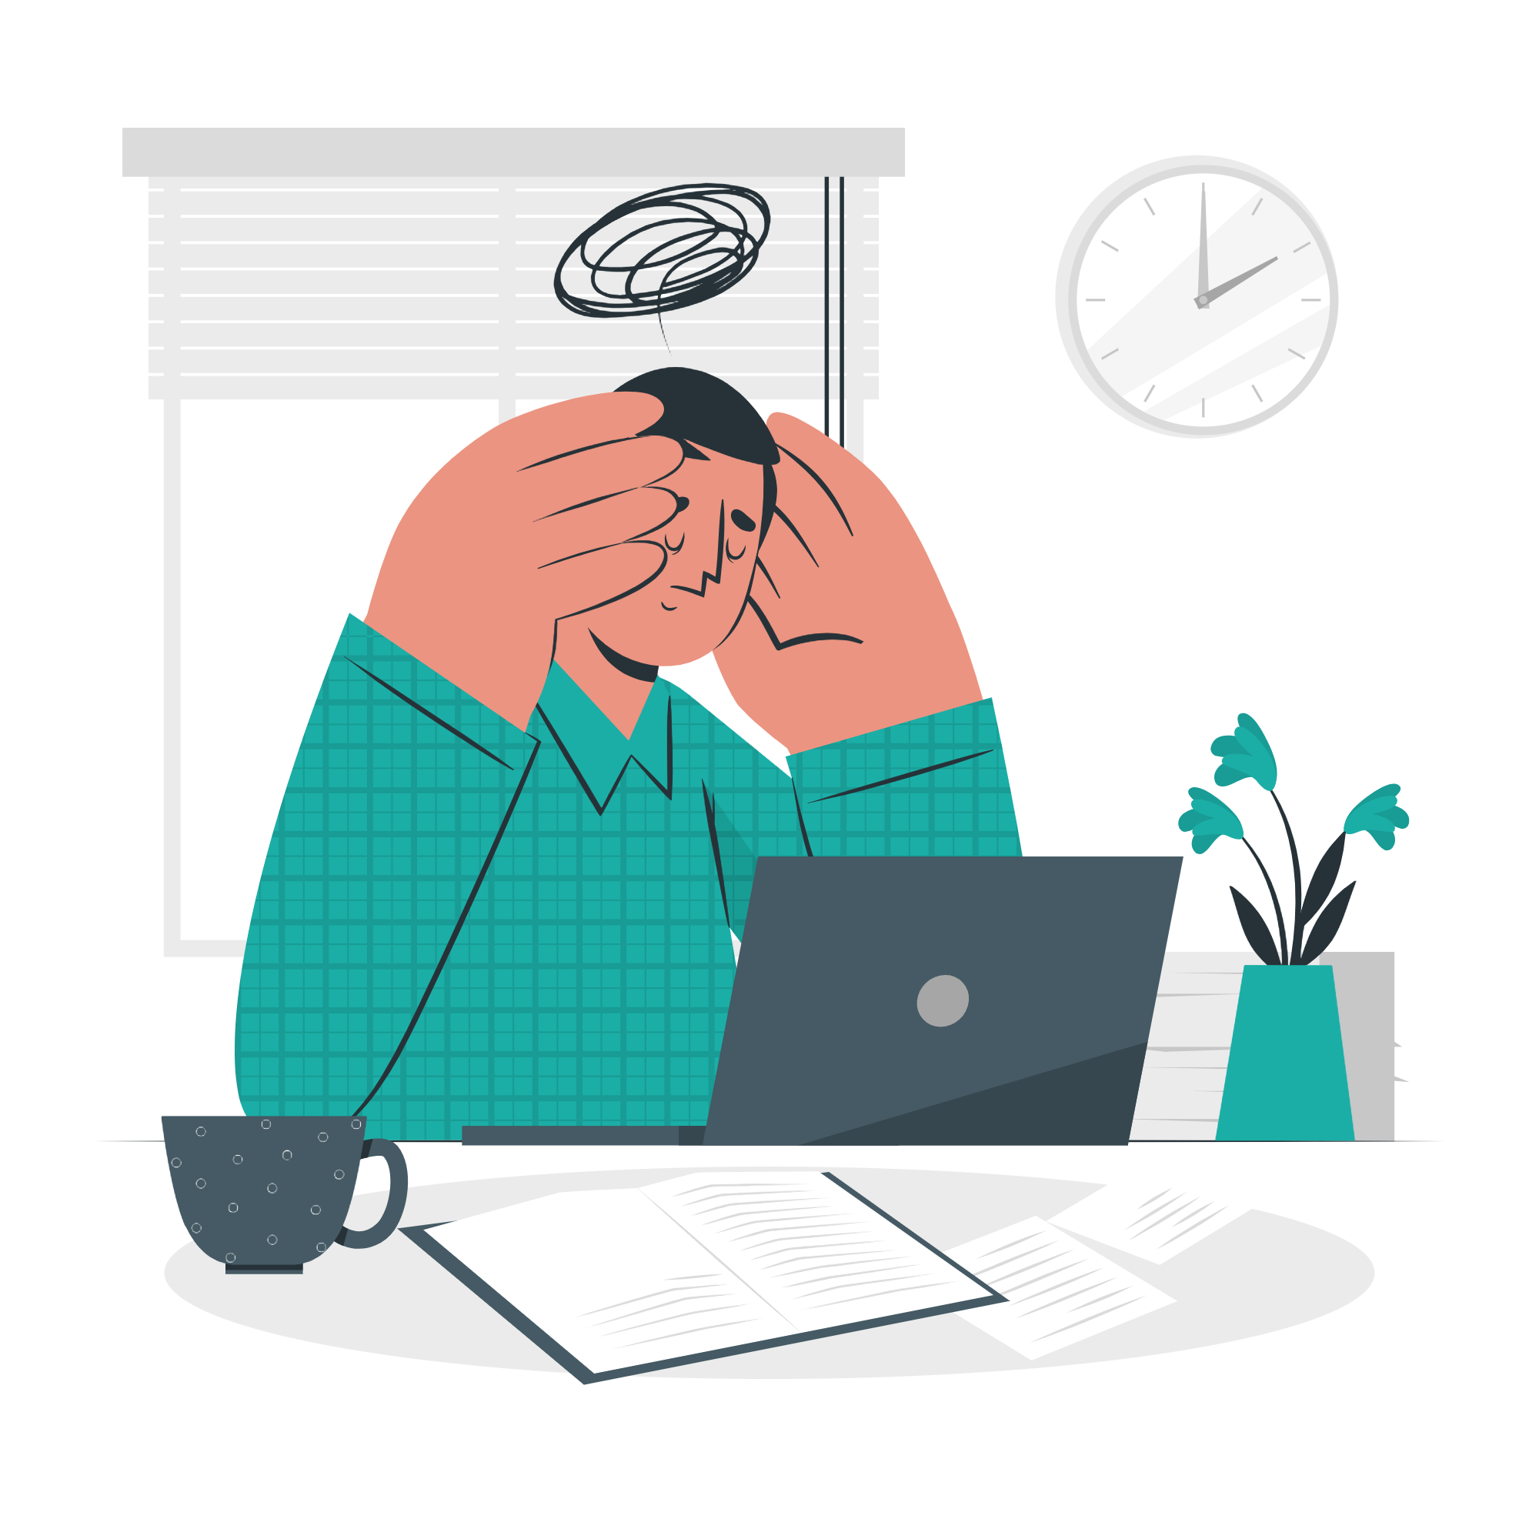
Limitations cont.
Google maps API:
Google maps API was considered a limitation as it wasn’t free to use.

Slide 36
Future Work

Slide 37




Video calls
Prescription detection
Pharmacy recommendation
Measuring blood pressure, pulse and temperature

Slide 38

Thanks!
Any questions?
Special thanks from MobiCare team to our supervisor Prof.Doaa Saad for her efforts.

